Slide 1


Focus Web Developer
Week 2 – Lesson 2
Notes:
Welcome your class, think about what is the hook to engage your students right out of the starting gate.

Slide 2
Lesson Topics
HTML 5 Practice Continued
Notes:
Pre-test
Two-way learning

Slide 3
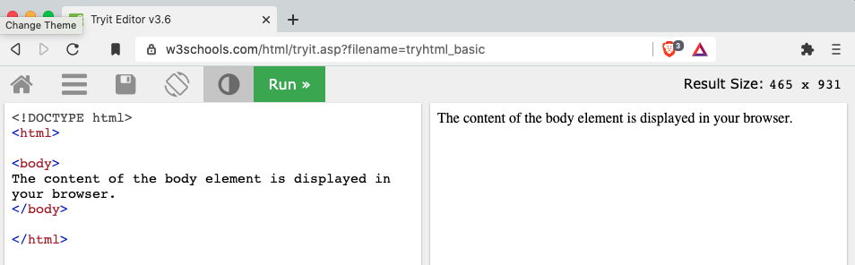
Quick tip!
Bookmark this URL: https://www.w3schools.com/html/tryit.asp?filename=tryhtml_basic
use this to test little bits of code!

Slide 4
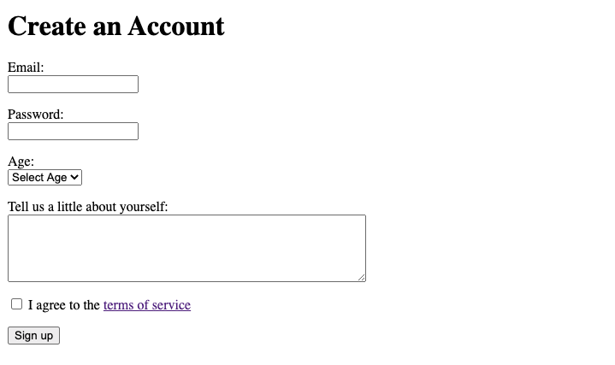
Activity 1 Introduction
Create the following webpage using only HTML
This is an example of a <form> in HTML
Dropdown menu
checkbox
Activity 4 is from https://www.delidded.com/html-css-practice-test/

Slide 5
Activity 1 Introduction
In addition to the <tags> in your boilerplate, here are some of the <tags> to create this webpage:
<h1> - Defines a hyperlink
<form> - Defines an HTML form for user input
<input> - Defines input control
<label> - Defines a label for an <input> element
<select> - Defines a dropdown list
<option> - Defines an option of a dropdown list
<textarea> - Defines a multiline input control (text area)
Note: this page has no <header> or <footer> tags
For a full list of HTML <tags> aka ”elements” go here:
https://www.w3schools.com/TAGs/

Slide 6
HTML <form> element
When the <form> element is used all these other elements can be nested within it
<input> - Defines input control
<label> - Defines a label for an <input> element
<select> - Defines a dropdown list
<option> - Defines an option of a dropdown list
<textarea> - Defines a multiline input control (text area)

Slide 7
HTML <input> element
<input> is used to take input from the user. Use the type and name attributes:
Example:
<input type = “text” name = “firstName”>
The input is stored type “text” (aka a string) by the computer
The input is stored with a name of “firstName” by the computer
This is like creating a variable named “firstName” that becomes whatever the user enters in the field
Note: <input> is a self closing tag and does not need a closing tag!
<input> blah blah blah </input>
Notes:
This slide needs editing to make it smoother.
Also look at HTML reference on W3 schools and show students how to get this information from there by themselves.

Slide 8


HTML <label> element
The <label> element creates labels for other elements.
no attributes are needed (here) for <label>
Example of how to use <label> and <input>
HTML Code
What you see in the web browser

Slide 9
HTML <select> element
The <select> element is used to define a drop-down. Use the attribute name.
Example:
<select name = “drop_down_list”>
this defines (or names) this drop-down list as “drop_down_list” for the computer to reference later – this will not be displayed

Slide 10
HTML <option> element
The <option> element makes options in a drop-down list that was defined with the <selector>. Use the value attribute:
Example of <option>:
<option value = “option1”> this is option 1< /option>
The value is what the computer stores this option as (not what is displayed)

Slide 11
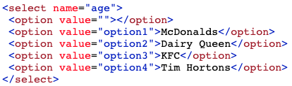
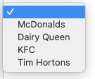
HTML <select> and <option> elements
Example of using <select> and <option> together:
HTML Code
What you see in the web browser
click
Why do you think value = “” is used in the first option tag?
Why is there no value in the menu before it is clicked?

Slide 12
HTML <textarea> element
The <textarea> element defines a multiline entry field for the user. Use the attributes name, rows and cols.
Example:
<textarea name= “userAnswer” rows = “10” columns = “5”>Some text</textarea>
name - this is what the computer stores the input as
rows - the height of the box
columns – the width of the text box

Slide 13

HTML <textarea> element
Example of using <textarea>:
HTML Code
What you see in the web browser

Slide 14

Activity 1 Instructions
Create the following webpage using only HTML
Requirements:
Use only HTML to make identical format
Save the file in your Activity 1 folder and name it “index.html”
Use <title>Activity 1</title> in the head
Use <label> to create labels for all input/menu fields
Use the <tags> covered in the previous slides
Terms of Service opens in a new tab
Note:
You will need to figure out how to make the checkbox and the Sign Up button at the bottom
Solution:
you can find the full solution on the next pages. Please DO NOT check this site until you have completely done this on your own
Activity 1 is from https://www.delidded.com/html-css-practice-test/
Notes:
Hint: checkbox and sign up button are made with the input element.
The ”fast” students completed this in about 1 hour.
This slide needs explanation of where the “terms of service” links to.

Slide 15
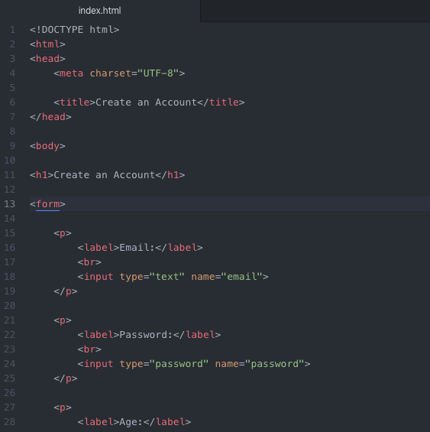
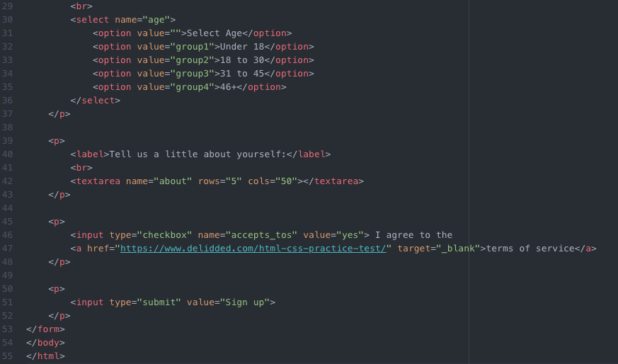
Activity 1 Solution
Activity 1 is from https://www.delidded.com/html-css-practice-test/
Notes:
Hint: checkbox and sign up button are made with the input element

Slide 16
Activity 1 Challenges
Once you have checked your code with your partner, try the challenge.
Duplicate your index.html file from Activity 1 into a new folder named “Activity 1 Challenge”
Challenges:
have example text in the Email, Password and ”Tell us a little about yourself”
put a black double border around all of the input fields (you will end up with a bunch of boxes, not just one)
change the background of each of the boxes above to different colours
Put the checkbox on the right side of the “I agree with the terms of service”
Center the “Sign Up” button
Activity 1 is from https://www.delidded.com/html-css-practice-test/
Notes:
Other ideas for challenges – have some type of confirmation after the user inputs information

Slide 17
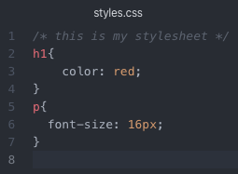
CSS
CSS is used to “style” your sheets
best practice is to name your CSS file “styles.css”
quick comment Ctrl + /

Slide 18
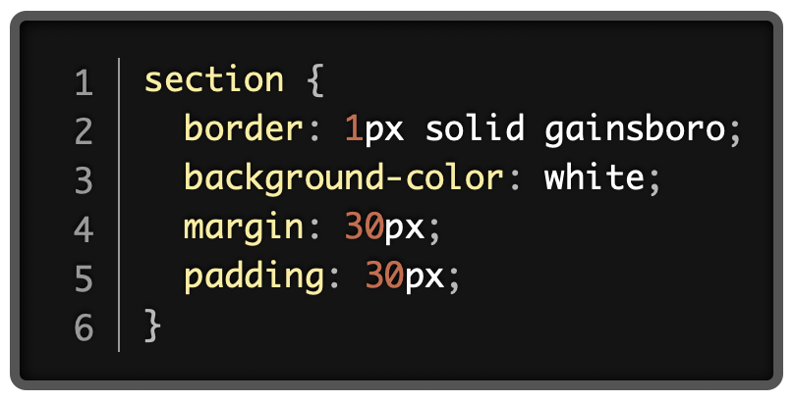
CSS
selector
The general format of CSS uses a selector followed by properties which have values
Selector – tells CSS what part of the HTML code the properties apply to
properties – exactly what will change
value – what the property is changed to
property
value
Notes:
include another slide that talks about types of selectors and how to use them
different properties for different elements
different value types based on properties

Slide 19
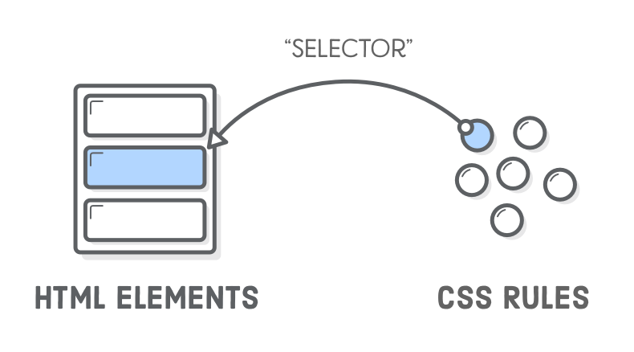
Selector Types
There are three ways you can select HTML elements to apply style to:
Element type
Class
Identifier

Slide 20

Class Selectors
Classes are way of grouping items that should or behave look the same way.
They are a powerful tool that give you complete style control over the elements on your page.

Slide 21
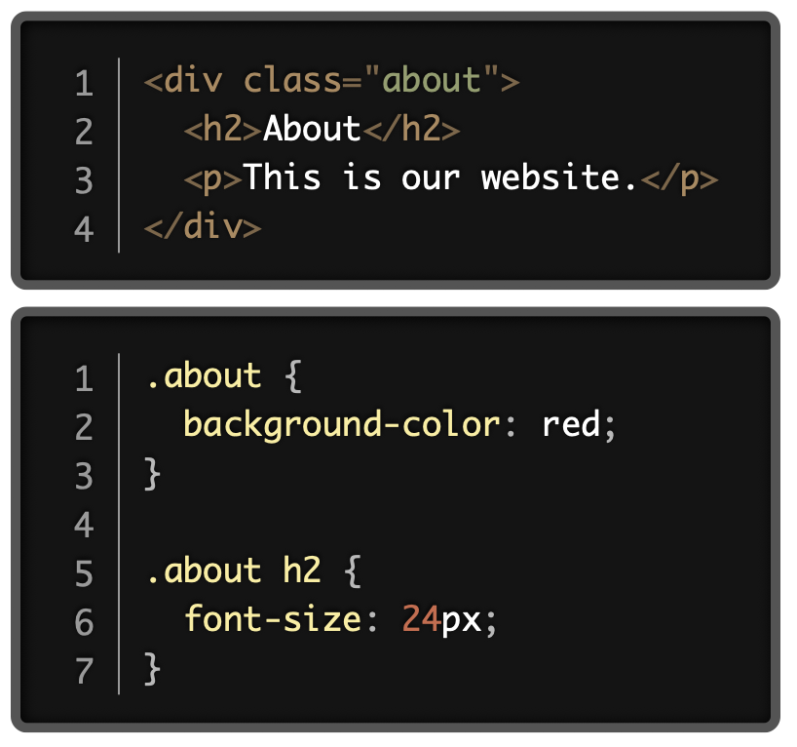
Class Selectors
Classes allow you to link your HTML to your CSS with custom values
This removes the limitation of styling your pages using only the built-in element types.

Slide 22
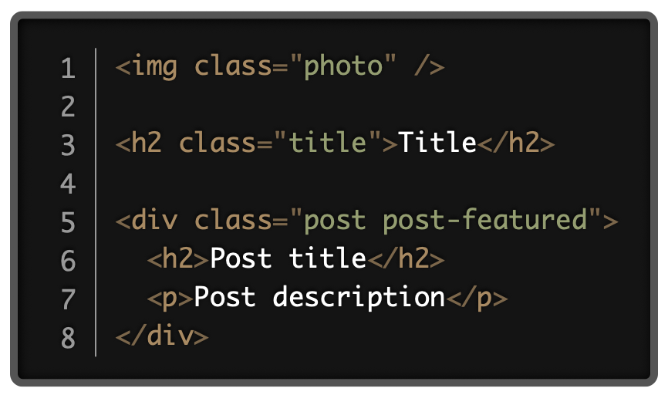
The class Attribute
A class attribute can be added to any HTML element.
Its value is defined by you.
An HTML element can be more than one class, and each is separated by a space.

Slide 23
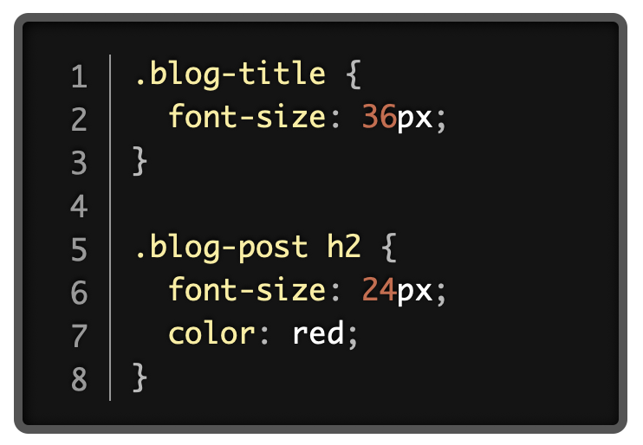
The class Selector
Class declarations are written using a period . followed by the class name
Declarations for a class will apply to every element that has that class attribute in the HTML
Otherwise they work exactly the same as type selectors

Slide 24
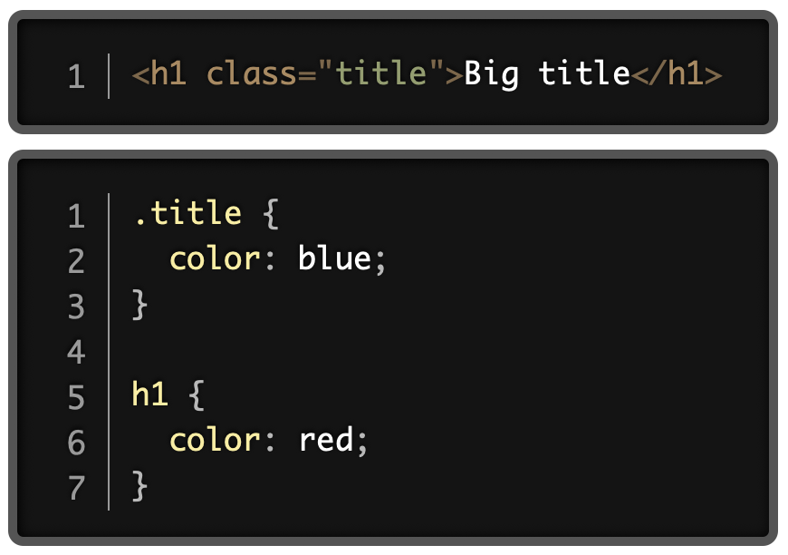
Class Specificity
Classes are more specific than regular type selectors.
The <h1> element will be blue in this example, even though the h1 rule comes after the .title rule.

Slide 25
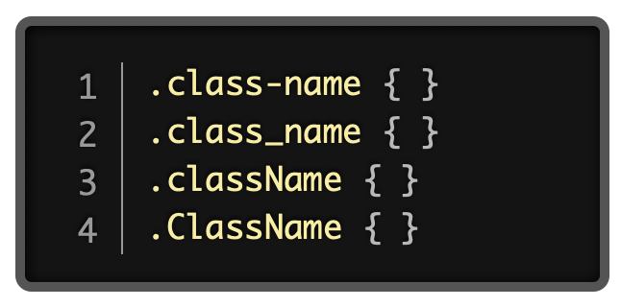
Class Naming
These are all different!
CSS has naming conventions just like in HTML.
When choosing a class name, choose something descriptive, functional and concise.
Spaces are not allowed.
Class names are case sensitive.

Slide 26




Class Naming
Use this for now!
Dashed case
Camel case
Snake case
Pascal Case

Slide 27
Selector Types
There are three ways you can select HTML elements to apply style to
Element type
Class
Identifier

Slide 28
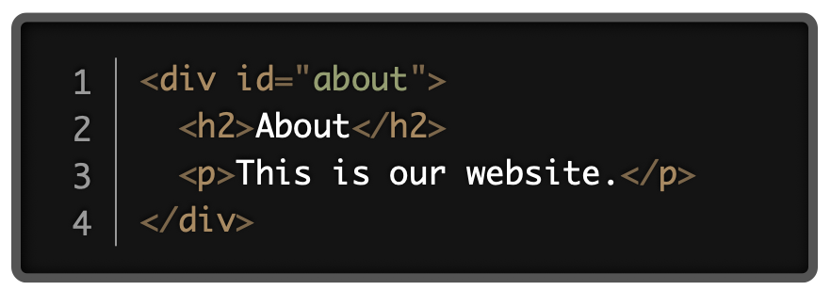
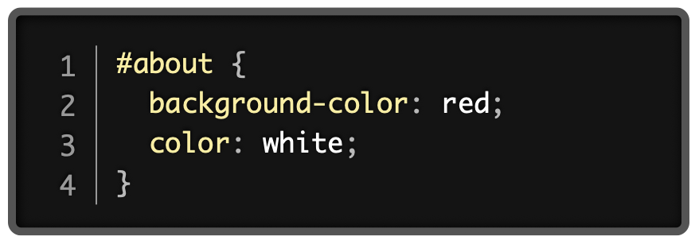
ID Selectors
Identifiers can style elements in the same way as classes
IDs are denoted using the hash symbol # plus the name (just like internal link)
The id attributes can only be used once per page

Slide 29

Best Practices
ID selectors are finicky and prone to creating bugs.
Type and class selectors are much more reliable, so try to use these where possible.

Slide 30


Activity 2 Introduction
Create the following webpage using HTML and CSS
sliiiiiiightly lighter blue
buttons change colour when mouse is hovered over
Activity 2 is from https://www.delidded.com/html-css-practice-test/html-css-practice-problems/

Slide 31
Activity 2 Instructions
Create the following webpage using HTML and CSS
Requirements:
Use HTML and CSS to make these buttons change colour when you hover over them. You can choose the colours and text style.
Save the files in your Activity 2 folder
Use <title>Activity 2</title> in the head
Use classes only to do this, do not use id’s
Note:
make sure there is space between the buttons and they have rounded corners
Solution:
you can find the full solution on the next pages. Please DO NOT check this site until you have completely done this on your own
when the mouse is hovered over the buttons they should change colour
Activity 2 is from https://www.delidded.com/html-css-practice-test/html-css-practice-problems/

Slide 32
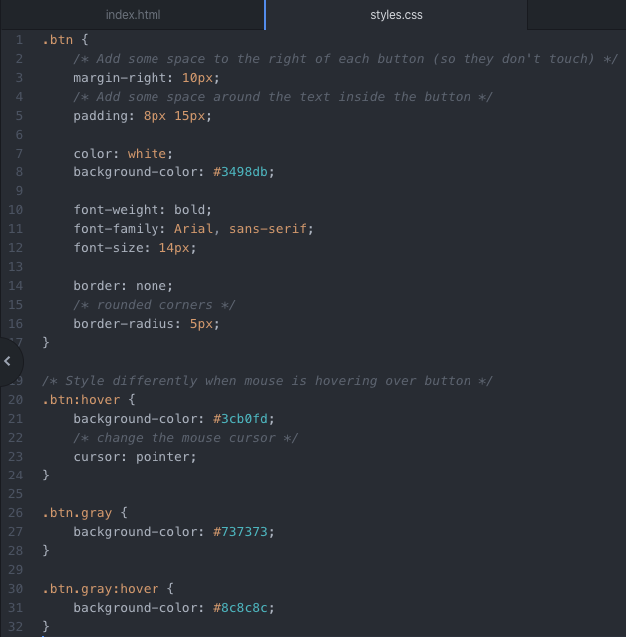
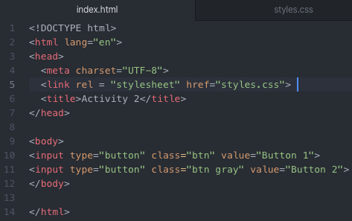
Activity 2 Solution
Activity 2 is from https://www.delidded.com/html-css-practice-test/html-css-practice-problems/

Slide 33

Activity 2 Challenge
Once you have checked your code with your partner, try the challenge.
Duplicate your index.html file from Activity 2 into a new folder named “Activity 2 Challenge”
Challenges:
animate the buttons to have arrows as shown below
See what else you can animate the button to do!
Activity 2 is from https://www.delidded.com/html-css-practice-test/html-css-practice-problems/

Slide 34
Gathering Time
Gathering Time is a time for check-in.
Notes:
Instructors Notes:
Introduce the concept of Gathering Time, which will be used throughout the program.
The sharing stone can be just a stone someone in the class wants to use or one from outside.
It just reminds everyone to listen when the person with the stone talks, so everyone has an opportunity to listen.
Chairs only
Someone from the host Nation can be offered to start the check-in first. If no one is interested then someone else in the group, or the Instructor, will be offered to start it next.

Slide 35

Class Wrap-up
How was your day?
How’s your website coming along?
Are you excited to add some colour?
Notes:
Post test: provide the students with feedback about the day, review the day.
End of the day Q/A
Were the day’s goals met (reference slide 2)?
Transition: what’s coming up tomorrow?

